Slide 1
Implementation of Graphs

Slide 2
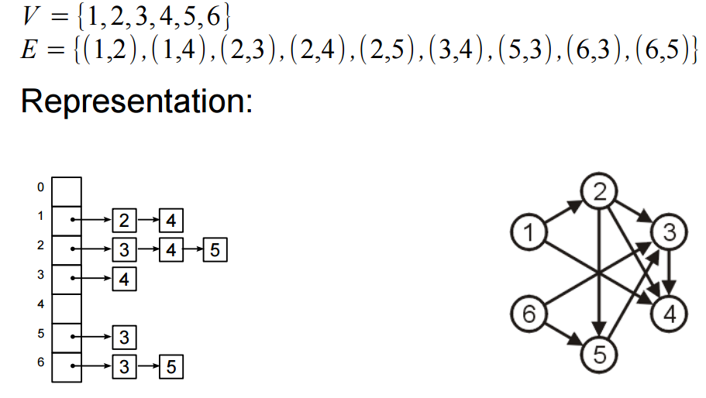
ADJACENCY LIST IMPLEMENTATION

Slide 3
Recap: Recall the difference between the two
Student *s = new Student[2];
s[0].display();
s[1].display();
‘s’ an array of two student objects
Student *s[2];
s[0] = new Student();
s[1] = new Student();
s[0]->display();
s[1]->display();
‘s’ an array of two pointers to objects of class student

Slide 4
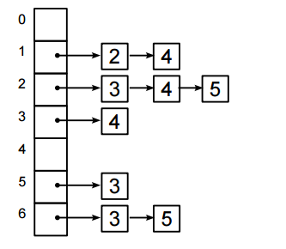
Implementation of graphs
class AdjListNode
{
public:
int dest;
AdjListNode* next;
};

Slide 5
Implementation of graphs
class AdjList
{
public:
AdjListNode *head;
};
We’ll have an array of these AdjList (heads) – one for each list

Slide 6
Implementation of graphs
class Graph
{
public:
int V; \\Number of vertices
AdjList* arr; \\ An Array of adj lists
Graph(int V);
AdjListNode* newAdjListNode(int);
void addEdge(int, int);
void printGraph();
};

Slide 7
Implementation of graphs
Graph::Graph(int V)
{
this->V = V;
arr = new AdjList [V];
for (int i = 0; i < V; ++i)
arr[i].head = NULL;
}

Slide 8
Implementation of graphs
AdjListNode* Graph::newAdjListNode(int dest)
{
AdjListNode* newNode = new AdjListNode;
newNode->dest = dest;
newNode->next = NULL;
return newNode;
}

Slide 9
Implementation of graphs
void addEdge(int src, int dest)
{
AdjListNode* newNode = newAdjListNode(dest);
newNode->next = arr[src].head;
arr[src].head = newNode;
//for undirected graph add the following
newNode = newAdjListNode(src);
newNode->next = arr[dest].head;
arr[dest].head = newNode;
}

Slide 10
Implementation of graphs
void printGraph()
{
int v;
for (v = 0; v < V; ++v)
{
AdjListNode* pCrawl = arr[v].head;
cout<<"\n Adjacency list of vertex "<<v<<"\n head ";
while (pCrawl)
{
cout<<"-> "<<pCrawl->dest;
pCrawl = pCrawl->next;
}
cout<<endl;
}
}

Slide 11
Implementation using stl ‘list’ class
class Graph
{
int V; //No if vertices
list<int> *adj; lists
public:
Graph(int V);
void addEdge(int v, int w);
};
Graph::Graph(int V)
{
this->V = V;
adj = new list<int>[V];
}
void Graph::addEdge(int v, int w)
{
adj[v].push_back(w); // Add w to v’s list
}

Slide 12
Adjacency matrix implementation of a graph
class Graph {
private:
bool** adjacencyMatrix;
int vertexCount;
public:
Graph(int vertexCount);
void addEdge(int i, int j) ;
void removeEdge(int i, int j);
bool isEdge(int i, int j) ;
~Graph() ;
};

Slide 13
Adjacency matrix implementation of a graph
Graph::Graph(int vertexCount) {
this->vertexCount = vertexCount;
adjacencyMatrix = new bool*[vertexCount];
for (int i = 0; i < vertexCount; i++) {
adjacencyMatrix[i] = new bool[vertexCount];
for (int j = 0; j < vertexCount; j++)
adjacencyMatrix[i][j] = false;
}
}

Slide 14
Adjacency matrix implementation of a graph
void Graph::addEdge(int i, int j) {
if (i >= 0 && i < vertexCount && j > 0 && j < vertexCount)
{
adjacencyMatrix[i][j] = true;
//for undirected graph add the following
adjacencyMatrix[j][i] = true;
}
}

Slide 15
Adjacency matrix implementation of a graph
void Graph::removeEdge(int i, int j) {
if (i >= 0 && i < vertexCount && j > 0 && j < vertexCount)
{
adjacencyMatrix[i][j] = false;
//for undirected graph add the following
adjacencyMatrix[j][i] = false;
}
}

Slide 16
Adjacency matrix implementation of a graph
bool Graph::isEdge(int i, int j) {
if (i >= 0 && i < vertexCount && j > 0 && j < vertexCount)
return adjacencyMatrix[i][j];
else
return false;
}
Graph::~Graph() {
for (int i = 0; i < vertexCount; i++)
delete[] adjacencyMatrix[i];
delete[] adjacencyMatrix;
}

